Slide 1
IT2070 – Data Structures and Algorithms
Lecture 09
String Matching Algorithms
U. U. Samantha Rajapaksha
M.Sc.in IT, B.Sc.(Engineering) University of Moratuwa
Senior Lecturer SLIIT
Samantha.r@slit.lk

Slide 2
Contents
String Matching
The naïve string matching algorithm
The Rabin-Karp Algorithm
Finite automata

Slide 3
String Matching
The problem of finding occurrence(s) of a pattern string within another string or body of text.
There are many different algorithms for efficient searching.
String matching is a very important subject in the wider domain of text processing.

Slide 4

Applications
In string matching problems, it is required to find the occurrences of a pattern in a text.
Applications
Text processing
Text-editing e.g.Find and Change in word
Computer security (virus detection, password checking)
DNA sequence analysis.
Data communications (header analysis)

Slide 5
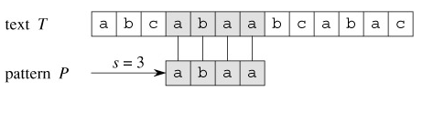
Example
Text T
A | B | C | A | B | A | A | B | C | A | B | A | C
Pattern P
A | B | A | A
Shift 1
A | B | A | A
Shift 2
A | B | A | A
A | B | A | A
Shift 3

Slide 6
String Matching problem
We formulize the String Matching problem as follows.
We assume that the text is an array T[1..n] of length n and the pattern is an array P[1..m] of length m.
We further assume that the elements of P and T are characters drawn from a finite alphabet ∑.
For example we may have ∑={0,1} or ∑={a,b,..z}.
The character arrays P and T are often called Strings of characters.

Slide 7
String Matching problem(contd.)
We say that pattern P occurs with shift s in text T (or, equivalently that pattern P occurs beginning at position s +1 in text T)
0≤ s ≤ n-m and T[s +1.. s +m] = P[1..m].
If P occurs with shift s in T, then we call s a valid shift; otherwise we call s an invalid shift.

Slide 8
Text T
A | B | C | A | B | A | A | B | C | A | B | A | A
Pattern P
A | B | A | A
Shift 0
Shift 1
A | B | A | A
Shift 2
A | B | A | A
Shift 3
A | B | A | A
Here, n = 13 m = 4 s = 3
S = 3 is a valid shift because
0≤ 3 ≤ 13-4 and T[3 +1.. 3 +4] = P[1..4].

Slide 9
String Matching problem(contd.)
The string-matching problem is the problem of finding all valid shifts with which a given pattern P occurs in a given text T.
1 | 2 | 3 | 4 | 5 | 6 | 7 | 8 | 9 | 10 | 11 | 12 | 13
A | B | C | A | B | A | A | B | C | A | B | A | A
Text T
Shift 3
A | B | A | A
…………..
Shift 9
A | B | A | A

Slide 10
The naive string-matching algorithm
The naïve algorithm finds all valid shifts using a loop that checks the condition P[1..m] = T[s+1..s+m] for each of the n-m+1 possible values of s.
Naïve-String-Matcher (T, P)
1 n = T.length
2 m = P.length
3 for s = 0 to n-m
4 if P[1..m] = T[s+1..s+m]
5 print "Pattern occurs with shift" s

Slide 11
When does worst case happen?
1 | 2 | 3 | 4 | 5 | 6 | 7 | 8 | 9 | 10 | 11 | 12 | 13
A | A | A | A | A | A | A | A | A | A | A | A | X
Text T
Pattern P
A | A | A | X
A | A | A | X
…………..
A | A | A | X

Slide 12
Worst case Analysis
This algorithm takes O((n-m+1)m) in the worst case
There are at most n-m +1 shifts
m is to compare each string after shifting
Therefore worst case takes O((n-m+1)m)
E.g. In above example
O( (13-4+1) 4 ) comparisons
Shiftings
Comparing for each shift

Slide 13
Best case analysis
1 | 2 | 3 | 4 | 5 | 6 | 7 | 8 | 9 | 10 | 11 | 12 | 13
A | A | A | A | A | A | A | A | A | A | X | X | X
Text T
Pattern P
B | A | A | C
B | A | A | C
…………..
B | A | A | C
No of shifts (13-4+1)
No of comparisons O((n-m+1) 1)

Slide 14
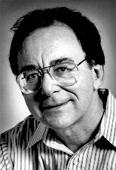

The Rabin-Karp Algorithm
Professor.Richard Karp Harvard University
Professor Michel Rabin Harvard University
Invented by Professor Richard Karp an Professor Michel Rabin in 1984.

Slide 15
The Rabin-Karp Algorithm
Given Text
2 | 3 | 5 | 9 | 0 | 2 | 3 | 1 | 4 | 1 | 5 | 2 | 6 | 7 | 3 | 9 | 9 | 2 | 1
Using modulo 13
Find the occurrence of pattern
3 | 1 | 4 | 1 | 5
2 | 3 | 5 | 9 | 0 | 2 | 3 | 1 | 4 | 1 | 5 | 2 | 6 | 7 | 3 | 9 | 9 | 2 | 1
3 | 1 | 4 | 1 | 5

Slide 16
Method
Take the window size of the pattern
Start from the beginning of the text taking windows
Calculate the modulo value of that window
Check it with the modulo value of the pattern
3 | 1 | 4 | 1 | 5
mod 13
7
Modulo value of the pattern

Slide 17
The Rabin-Karp Algorithm(contd.)
Let us assume that the input alphabet is {0,1,2,…,9},so that each character is a decimal digit.
We can then view a string of k consecutive characters as representing a length-k decimal number.
The character string 31425 thus corresponds to the decimal number 31,425.

Slide 18
The Rabin-Karp Algorithm
2 | 3 | 5 | 9 | 0 | 2 | 3 | 1 | 4 | 1 | 5 | 2 | 6 | 7 | 3 | 9 | 9 | 2 | 1
• • •
• • •
• • •
mod 13
8 | 9 | 3 | 11 | 0 | 1 | 7 | 8 | 4 | 5 | 10 | 11 | 7 | 9 | 11
Valid match
Spurious hit
All the hits should be checked further.

Slide 19
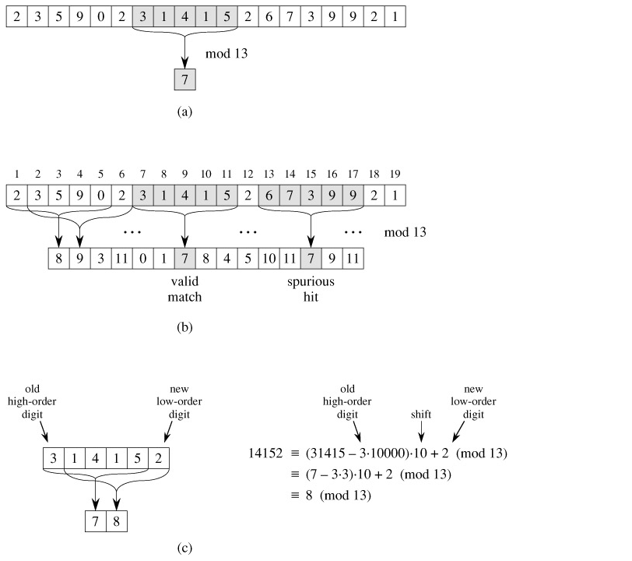

Slide 20
Analysis of Rabin-Karp
Comparing only the modulo value does not guarantee that the exact pattern is found.
On the other hand, if modulo values are not matched, then we definitely know that it is not the pattern.
All the hits must be tested further to see if the hit is a valid shift or just a spurious hit.
This testing can be done by explicitly checking the condition P[1..m] =T[s +1.. s +m]
If q is large enough, then we can hope that spurious hits occur infrequently enough that the cost of the extra checking is low.

Slide 21
Worst case & Best case
If all the hits are spurious hits then we have to check each of those.
Therefore the worst case occurs when all the hits are spurious hits
If all the hits are neither spurious hits nor valid hits we don’t have to check each of those.
Therefore the best case occurs when no hits occurred

Slide 22
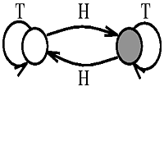
String matching with finite automata
Many string-matching algorithms build a finite automaton that scans the text string T for all occurrences of the pattern P.
This section presents a method for building such an automaton.
These string-matching automata are very efficient: they examine each text character exactly once, taking constant time per text character.

Slide 23

Definition of a finite automaton
A finite automaton M is a 5-tuple (Q, q_{o}, A, Σ, δ), where
Q is a finite set of states,
q ε Q is the start state,
A ⊆ Q is a distinguished set of accepting states,
∑ is a finite input alphabet,
δ is a function from Q x ∑ into Q,, called the transition function of M.

Slide 24
Example
a
input
0
1
b
state | a | b
0 | 1 | 0
1 | 0 | 0
a
b
A simple two-state finite automaton with state set Q= {0,1},
start state q₀ = 0,
Accepting state A = 1
input alphabet ∑ = {a,b}
A tabular representation of the transition function δ

Slide 25
Finite automata(contd.)
Directed edges represent transitions.
For example, the edge from state 1 to state 0 labeled b indicates δ ( 1, b) = 0.
This automaton accepts those strings that end in an odd number of a's.
For example, the sequence of states this automaton enters for input abaaa (including the start state) is (0, 1, 0, 1, 0, 1) , and so it accepts this input.
For input abbaa, the sequence of states is (0, 1,0,0, 1,0), and so it rejects this input.

Slide 26
Example. Accepts all strings ending in the string ababaca.
(a) A state-transition diagram for the string-matching automaton that accepts all strings ending in the string ababaca. State 0 is the start state, and state 7 (shown blackened) is the only accepting state. A directed edge from state i to state j labeled a represents δ(i, a) = j. The right-going edges forming the "spine" of the automaton, shown heavy in the figure, correspond to successful matches between pattern and input characters. The left-going edges correspond to failing matches. Some edges corresponding to failing matches are not shown; by convention, if a state i has no outgoing edge labeled a for some a ∈ Σ, then δ(i, a) = 0.
(b) The corresponding transition function δ, and the pattern string P = ababaca. The entries corresponding to successful matches between pattern and input characters are shown shaded.
(c) The operation of the automaton on the text T = abababacaba. Under each text character T [i] is given the state φ(Ti) the automaton is in after processing the prefix Ti. One occurrence of the pattern is found, ending in position 9.

Slide 27
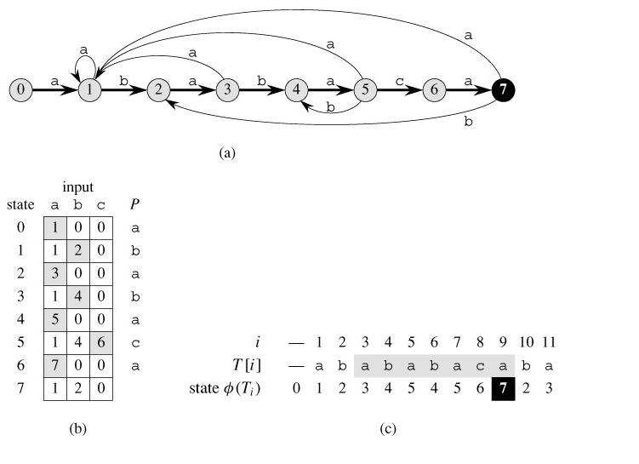

Slide 28
Summary
String Matching
The naïve string matching algorithm
The Rabin-Karp Algorithm
Finite automata

